Slide 1

SECTION 2
Static Games of Complete Information
TOPIC 1
The Normal-Form Representation
MODULES
Introducing Games
Static Games of Complete Information
A Pure Strategy
The Normal-Form Game
Canonical Games…
Class 11

Slide 2

Logistics
Exams and Grading Scheme
Exam 2
April
24
Friday
2:30 – 4 PM
Focus
Problem-solving
Exam 1
February
27
Friday
2:30 – 4 PM
35%
25%
Test 1
February
3
Tuesday
4 – 5:30 PM
Test 2
March
27
Friday
2:30 – 4 PM
Focus
Conceptual understanding
Attendance
15%
15%
10%

Slide 3

MODULE 8
Matching Pennies
The Normal-Form Representation
(Discrete Strategy Spaces)
Two player

Slide 4

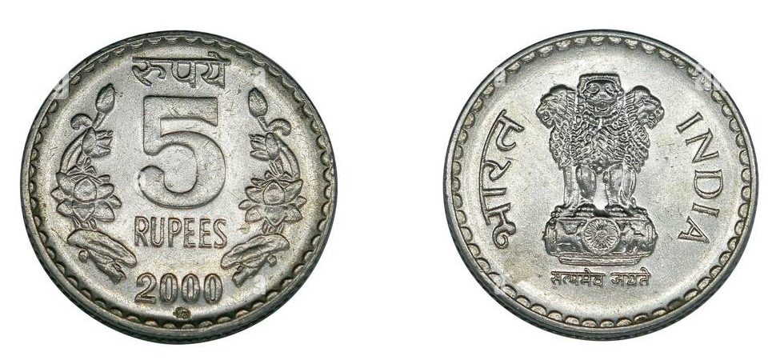
The Scenario
EXAMPLE
Game Setup
Two players simultaneously choose to show either the Head or Tail of a coin
If both players show the same side, Player 1 wins. Player 2 pays Player 1 ₹1
If they show different sides, Player 2 wins. Player 1 pays Player 2 ₹1
Player 1
Coin 1
Player 2
Coin 2
Preferences
Each player cares only about the amount of money they receive and prefers receiving more than less.
…not a coin toss
…face to show = strategy, not random selection
…we’ll revisit this game when discussing mixed strategies later
…sometimes, there’s wisdom in tossing a coin to choose a strategy (being unpredictable)

Slide 5











The Normal-Form Representation
Players
$$N=\left\{1, 2\right\}$$
Strategy sets
$$S_{i}=\left\{H, T\right\}$$
for
$$i∈\left\{1, 2\right\}$$
Payoffs
$$v_{1}\left(H, H\right)=+1$$
$$v_{2}\left(H, H\right)=−1$$
$$v_{1}\left(T, T\right)=+1$$
$$v_{2}\left(T, T\right)=−1$$
$$v_{1}\left(H, T\right)=−1$$
$$v_{2}\left(H, T\right)=+1$$
$$v_{1}\left(T, H\right)=−1$$
$$v_{2}\left(T, H\right)=+1$$

Slide 6







The Matrix Representation
Two-player finite game
Player 2
$$H$$
$$T$$
$$H$$
$$1, −1$$
$$−1, 1$$
Player 1
$$T$$
$$−1, 1$$
$$1, −1$$

Slide 7

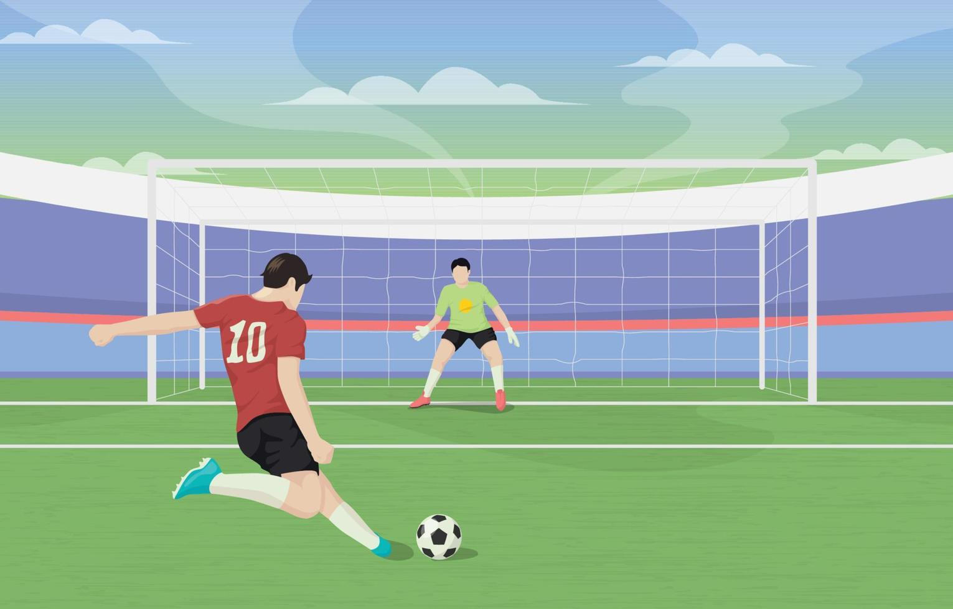







Game Structure
Player 2
$$H$$
$$T$$
$$H$$
$$1, −1$$
$$−1, 1$$
Strictly competitive interactions: Alignment versus Opposition
The game models a situation in which—
One player prefers mutual alignment
Player 1
$$T$$
$$−1, 1$$
$$1, −1$$
The other player prefers mutual opposition
…role of unpredictability
Cooperation (Mutual benefit) isn’t even an option
…one player’s gain = other player’s loss
Opposing Interests
Win, Lose
…zero-sum game

Slide 8







Product Appearance
EXAMPLE
Two firms, an established producer and a new entrant, are choosing product appearances in a market of fixed size. The established producer prefers the newcomer’s product to look different to retain its customers. The newcomer prefers the products to look alike to attract customers.
Player 2
$$S$$
$$D$$
$$S$$
$$1, 3$$
$$3, 1$$
Player 1
$$D$$
$$3, 1$$
$$1, 3$$

Slide 9



Imitation vs. Uniqueness
EXAMPLE
One person desires to be like the other, aiming for similarity, while the other seeks to distinguish themselves, preferring difference.
Player 2
$$S$$
$$D$$
$$S$$
$$0, 1$$
$$1, 0$$
Player 1
$$D$$
$$1, 0$$
$$0, 1$$

Slide 10
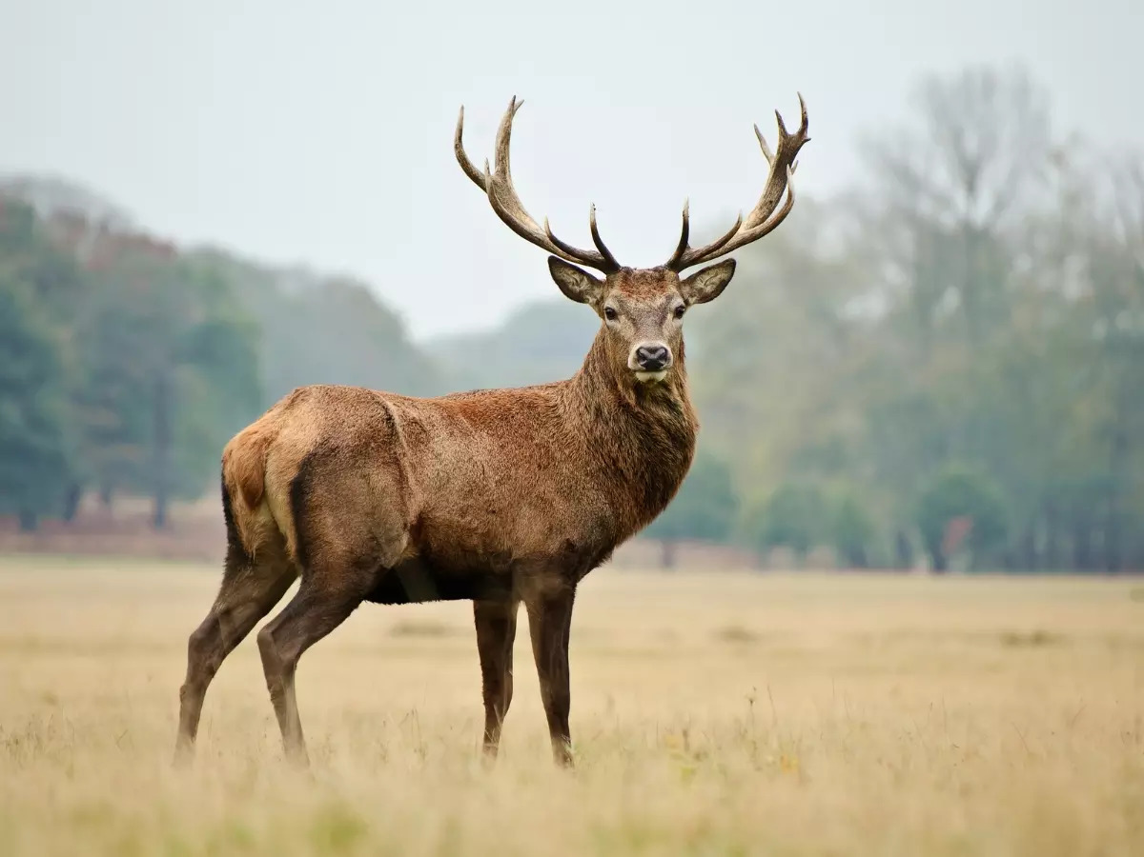
MODULE 9
The Stag Hunt
The Normal-Form Representation
(Discrete Strategy Spaces)

Slide 11
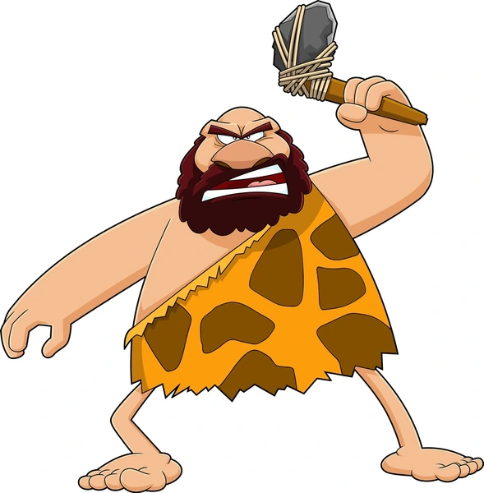
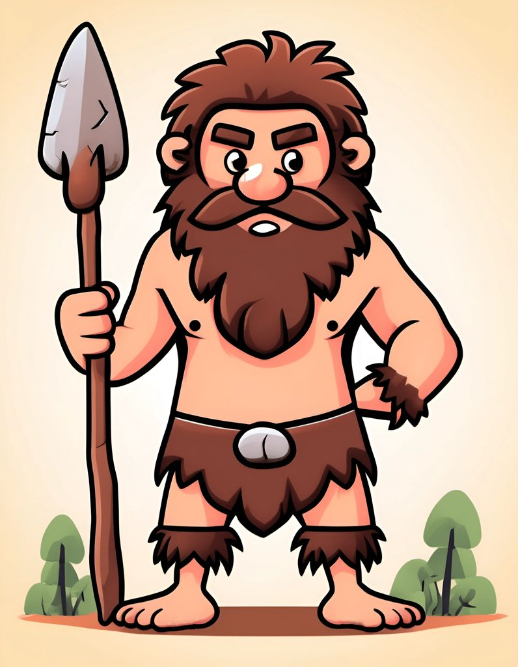



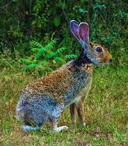
The Scenario: Stag or Hare
High risk/reward
EXAMPLE
Game Setup
A group of hunters must choose between cooperating to catch a stag or individually catching a hare.
If all cooperate, they succeed in catching the stag and share it equally.
If even one hunter defects to catch a hare, the stag escapes, and the defector keeps the hare.
Preferences: Each hunter values a share of the stag more than a hare (but may hunt the hare due to lack of trust in the other hunters’ commitment).
Low risk/reward

Slide 12
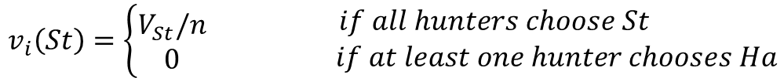




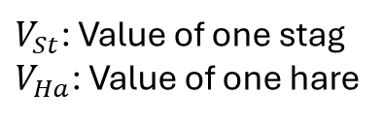





The Normal-Form Representation
Players
$$N=\left\{1, 2, …, n\right\}$$
The $n$ hunters
Strategy sets
for
$V_{St}$: Value of one stag
$V_{Ha}$: Value of one hare
$$S_{i}=\left\{St, Ha\right\}$$
$$i∈\left\{1, 2, …, n\right\}$$
Payoffs
For any player $i∈N$
$$V_{St}>{nV}_{Ha}$$
If $i$ chooses $St$
…incentive to cooperate and go for the bigger kill
$$v_{i}\left(St\right)=\left\{\begin{aligned}V_{St}/n \\ 0\end{aligned}\right.\begin{matrix}if all hunters choose St \\ if at least one hunter chooses Ha\end{matrix}$$
If $i$ chooses $Ha$
$$v_{i}\left(Ha\right)=V_{Ha}$$

Slide 13











The Matrix Representation
Only Two Hunters
Player 2
$$St$$
$$Ha$$
$$St$$
$$2, 2$$
$$0, 1$$
?
?
Player 1
$$Ha$$
$$1, 0$$
$$1, 1$$
?
?
$$V_{St}=4$$
$$V_{Ha}=1$$
$$V_{St}={4V}_{Ha}$$

Slide 14











Game Structure
Not always!
Player 2
Will rational players always cooperate?
$$St$$
$$Ha$$
$$St$$
$$2, 2$$
$$0, 1$$
Cooperation vs. Self-Reliance
The game models a situation in which each player—
Gains the most when all players cooperate
…like Prisoner’s Dilemma
Player 1
$$Ha$$
$$1, 0$$
$$1, 1$$
May settle for a guaranteed, smaller payoff by acting alone
…independent of what other players do
…unlike Prisoner’s Dilemma
…also rational!
Suboptimal outcomes—
Prisoner’s Dilemma: Temptation-driven defection
Stag Hunt: Lack of Trust-driven defection
Prisoner’s dilemma: Beliefs are strategically irrelevant
The Stag Hunt: Beliefs drive strategies
Prisoner’s dilemma: Rational players will never cooperate, regardless of trust
Rational players
Common knowledge of rationality
Stag Hunt: Communication → Trust → Cooperation
Prediction
$$\left\langle N, {\left\{S_{i}\right\}}_{i=1}^{n},{\left\{v_{i}\left(∙\right)\right\}}_{i=1}^{n}\right\rangle$$

Slide 15






Security Dilemma
EXAMPLE
Two countries face a security dilemma: both prefer mutual disarmament but may choose to arm themselves out of fear that the other might gain an advantage.
Player 2
$$D$$
$$A$$
$$D$$
$$3, 3$$
$$0, 2$$
Player 1
$$A$$
$$2, 0$$
$$1, 1$$

Slide 16
MODULE 10
Economic Models of Competition
The Basics
Good
Monopoly = Single-Person Decision Problem
Entity 1: The Firm (Decision-maker)
Entity 2: The Market (Customers), reacts mechanically based on distribution of value of the good, not strategically
The “Flipped” Demand Curve = Quantity-Price correlation = Fixed = Property of the market = Independent of firm(s)
Monopoly: Firm chooses one (Quantity or Price), market fixes the other
Duopoly #1: If firms choose quantities, then market (demand curve) fixes price based on total quantity of both firms
Duopoly #2: If firms choose prices, then market (demand curve) fixes quantity based on lower price
Duopoly = In either case, profits of each firm depend on decisions made by both firms = Game
Profits depend on Quantity & Price
Profit = Sales Revenue – Production Cost
Sales Revenue = Unit Price x Quantity
Production Cost = Unit Production Cost x Quantity (assume)
Profit = (Unit Price – Unit Production Cost) x Quantity
Profit = Function of Price & Quantity
Quantity or Price: Choose One
A firm can directly choose either quantity or price, not both independently. Once one is chosen, the market determines the other.
The “Flipped” Demand Curve
Horizontal axis: Price
Vertical axis: Number of customers willing to buy at that price
Downward sloping curve
Every market-good combination = different curve
Determining Profit from the “Flipped” Demand Curve
Good
Entity 1: Firm #1
Entity 2: Firm #2
Entity 3: The Market
Profit = Area of rectangle – Total Production Cost
Duopoly = Game

Slide 17
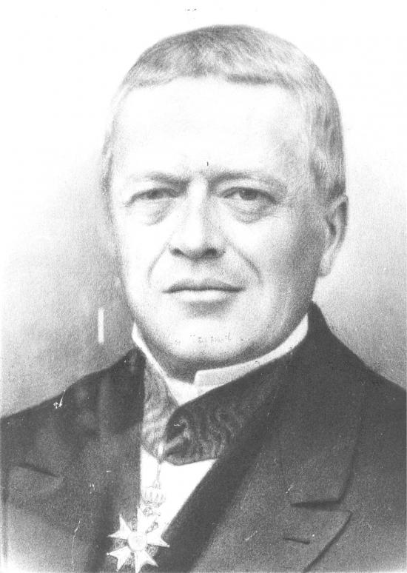
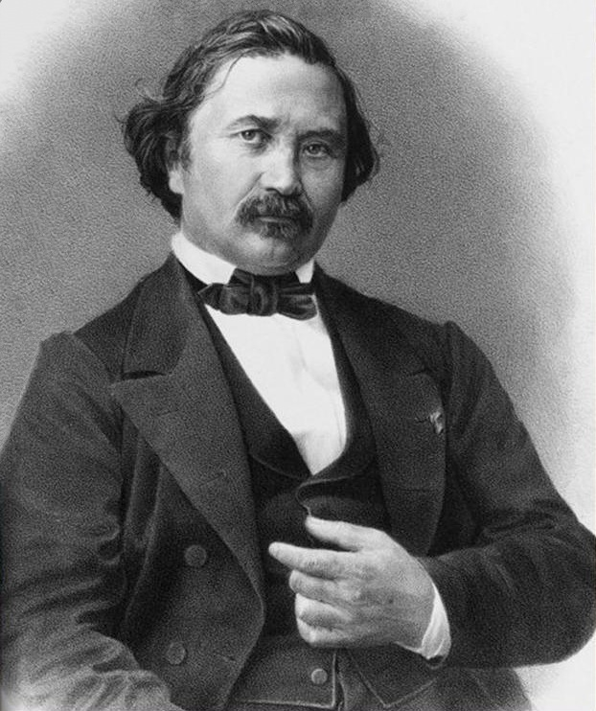





MODULE 10
Economic Models of Competition
‘Homogeneous’ good
Decision variables
Quantity
Linked through market demand
$$F_{1}$$
$$F_{2}$$
Price
$$M$$
Two
$$F_{3}$$
$$F_{n}$$
Interdependent decision-making
oligopoly
Games
Strategic behavior
‘few’ + ‘to sell’
Model: Cournot Competition
Model: Bertrand Competition
Each firm sells everything that it produces.
Each firm produces exactly how much it sells.
High setup, infrastructure costs
Easy to change ‘production capacity’ and price on the fly.
…at the price determined by the market.
…based on market demand for the chosen price
Difficult to change production capacity
Dynamic
Flexible
Producers
Static
Rigid
Sellers, Service providers
Oil, Steel, Cement production
Electricity generation
Agricultural goods: Milk, grain, meat
Supermarkets, retail/online stores
Airline tickets
Streaming services
19th Century French Mathematicians
…price-based competition
Firms decide quantities first.
…quantity-based competition
Firms set prices directly.
Price adjusts based on supply; same for all firms.
Quantities adjust in real time based on demand.
Customers buy from firms in proportion to their output.
Customers buy from the firm with the lower price.

